Slide 1
MGMT 410
Corporate Governance and Social Responsibility
Session 3 – Corporate Social Responsibility
Ozan Duygulu

Slide 2
Learning Objectives
Understanding the role of big business and the responsible use of corporate power in a democratic society.
Knowing when the idea of corporate social responsibility originated and investigating how a company’s purpose or mission can integrate social objectives with economic and legal objectives.
Examining the key arguments in support of and concerns about corporate social responsibility.
Defining global corporate citizenship and recognizing the rapidly evolving management practices to support global citizenship.
Examining businesses with an explicitly social mission, such as social ventures and B corporations.
Distinguishing among the sequential stages of global corporate citizenship.
Understanding how businesses assess and report their social performance

Slide 3
Corporate Power and Responsibility
Undeniably, businesses, especially large corporations—whether by intention or accident, and whether for good or evil—play a major role in all that occurs in society
Corporate power, refers to the capability of corporations to influence government, the economy, and society, based on their organizational resources

Slide 4
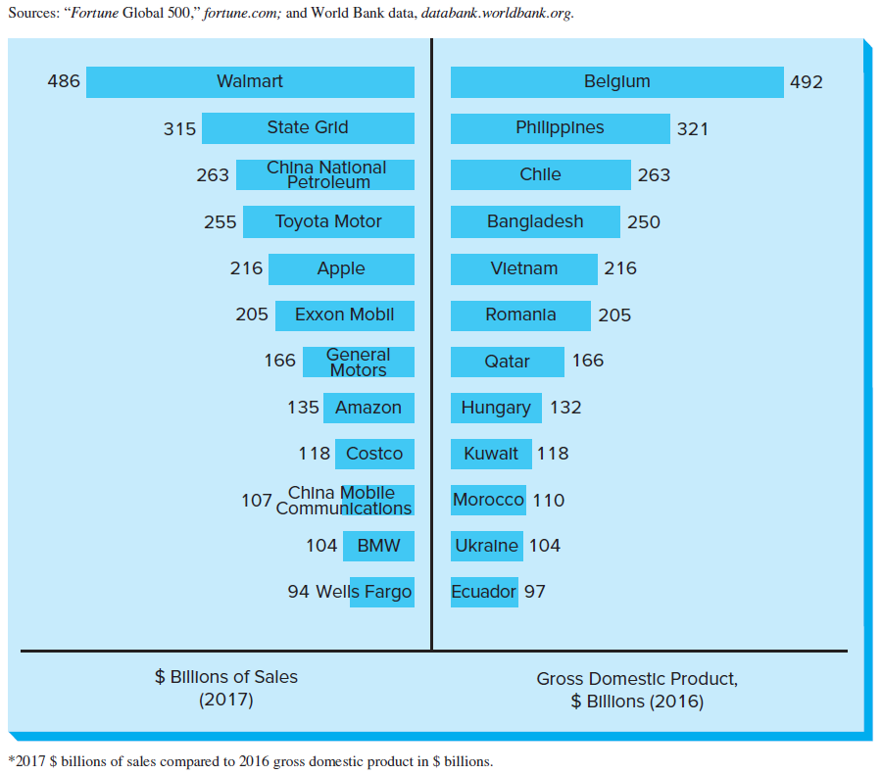
Corporations vs. Nations

Slide 5
Corporate Power and Responsibility
With great power comes great responsibility?
The iron law of responsibility says that in the long run those who do not use power in ways that society considers responsible will tend to lose it.
Corporations should? Is this a moral obligation?

Slide 6
Corporate Social Responsibility and Citizenship
Corporate social responsibility (CSR) means that a corporation should act in a way that enhances society and its inhabitants and be held accountable for any of its actions that affect people, their communities, and their environment
Responsibility: To pledge back
Corporate citizenship: The actions companies take to put their commitments to corporate social responsibility into practice

Slide 7
History of CSR
https://www.youtube.com/watch?v=KfKF44ZGPuQ

Slide 8
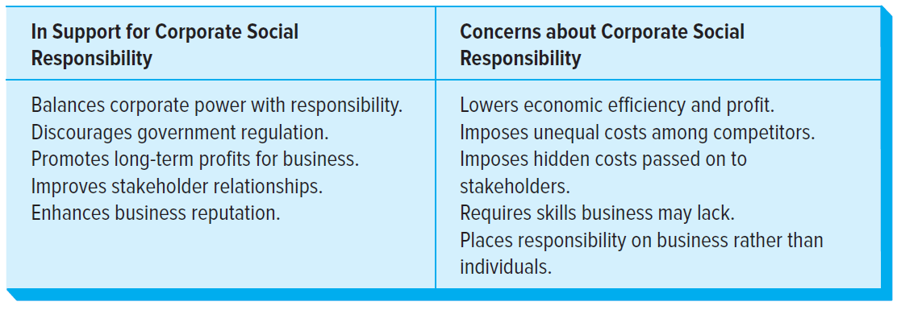
The Question of CSR

Slide 9
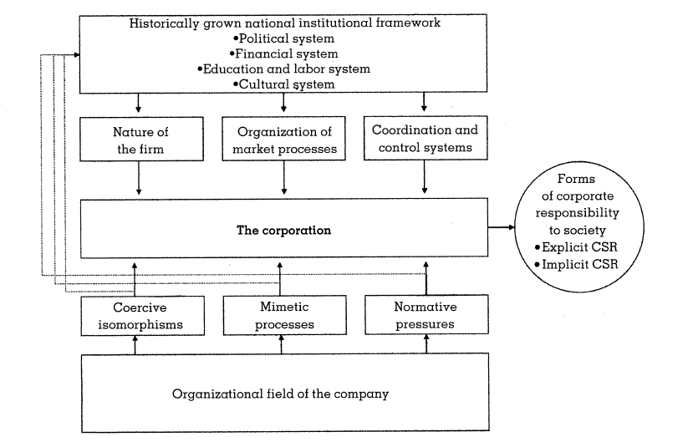
Context of CSR

Slide 10
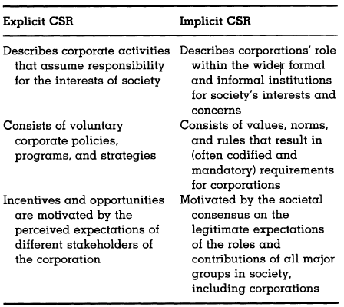
Context of CSR

Slide 11
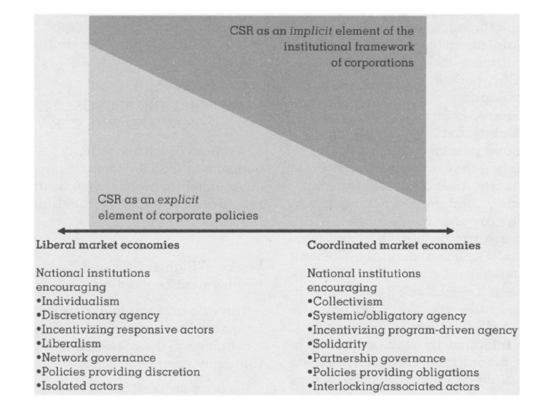
Implicit vs. Explicit CSR

Slide 12
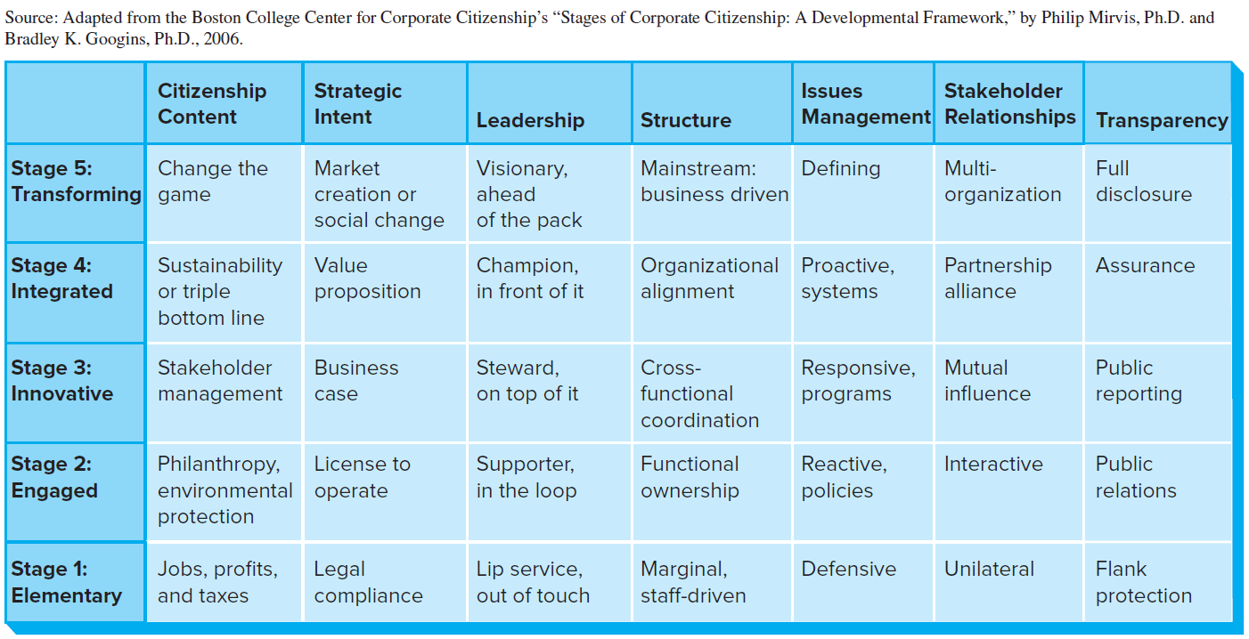
Stages of Global Corporate Citizenship

